Slide 1



Slide 2
Demo Day - Autumn 2020
December 10th 2020

Slide 3
Digital Marketing - Insights
Deepa Govindasamy
Mentors : Michael Maag, Shabnam

Slide 4


What is Digital Marketing
Marketing over Internet
Web browser, search engine, on social media, on mobile devices, and even in email.
Benefits:
reaches a wide audience
can be tracked to measure success (or failure)
can be personalized for a target audience
relatively inexpensive
Notes:
WHAT happend Spring 2020

Slide 5

Project Goals
Optimize and improve the business objectives
Targeting the right audience
Predicting who is most likely to click the advertisement
Notes:
WHAT happend Spring 2020

Slide 6
Project Approach
Environment Setup
Read and Examine Data
Data Cleaning
Analysis and Visualization
Prediction and Model fitting
Import the required libraries such as pandas, numpy, matplotlib etc
Understand the raw data, data types, meta data and dataset format
Perform data cleaning to remove empty cells , remove irrelevant data or columns.
Implement analytical methods and visualize, perform Exploratory Data Analysis
Work on the best fitting prediction model
1
2
3
4
5

Slide 7
Factors Influencing
Gender
Geo region
Click on Ad
Internet Usage
Age
Time spent on site
Notes:
WHAT happend Spring 2020

Slide 8
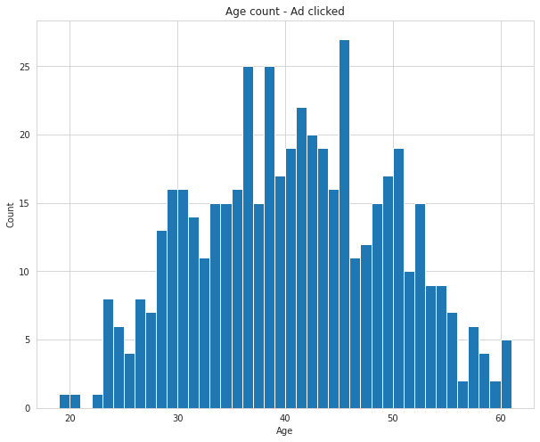
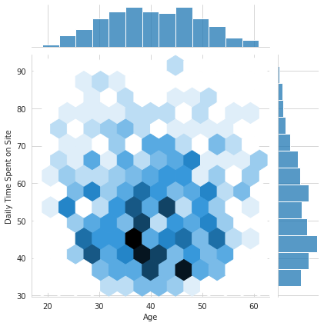
Findings 1 - Ad Clicked and Age factor
Major number of users are between the age group 35-45
People between this age group has spent less time on site.

Slide 9
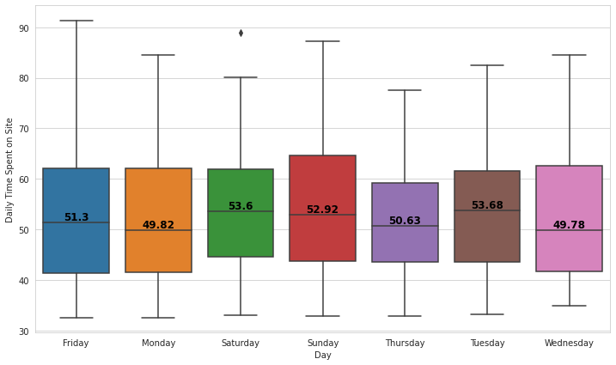
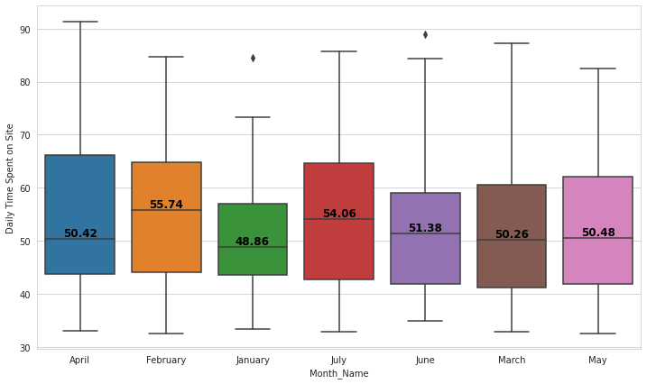
Findings 2 - Daily Time spent vs days and months
The average Time spent by the user who clicked on Ad comparatively seems to be higher during Weekends and Tuesday and in the month of February and July

Slide 10
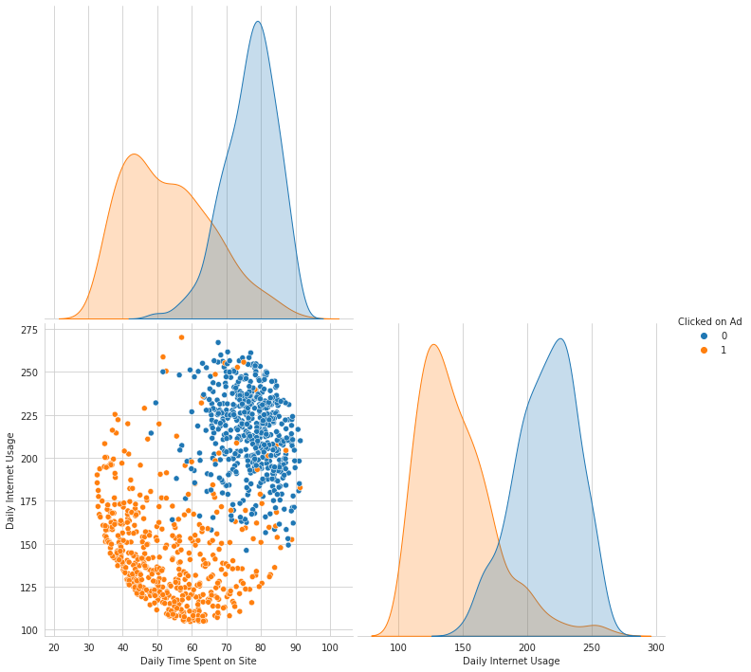
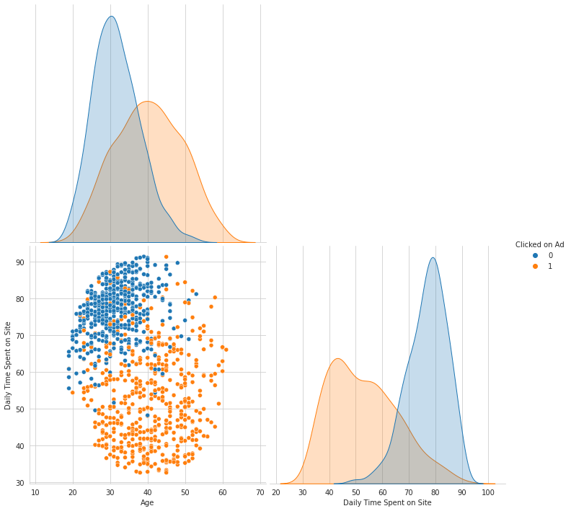
Ad Clicked - Exploratory Analysis
Users who spend less time on Site and with less Internet usage have clicked on the Ads.
Users between age group 35-45 and spending less time on Site and have clicked on the Ads

Slide 11
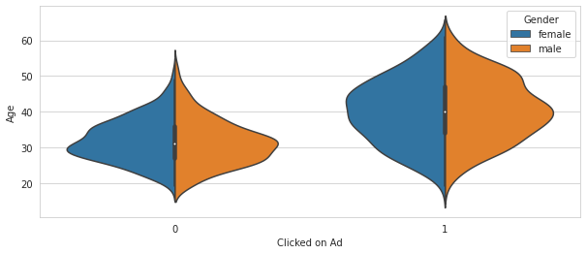
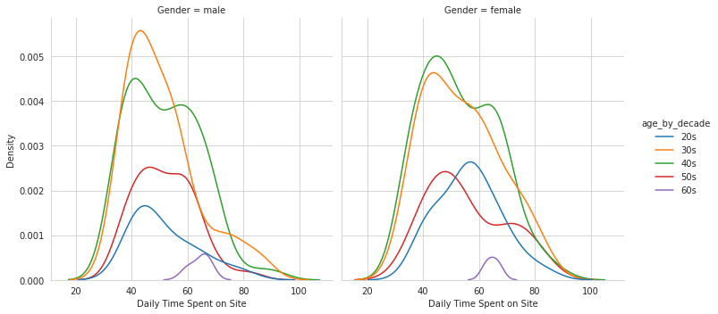
Ad Clicked - Gender Analysis
Gender wise density distribution of Ad clicked and not clicked is similar and more concentrated around the age 35-45
Gender density analysis reveals both Male and Female between the age group 35-45 have clicked on the Ad

Slide 12
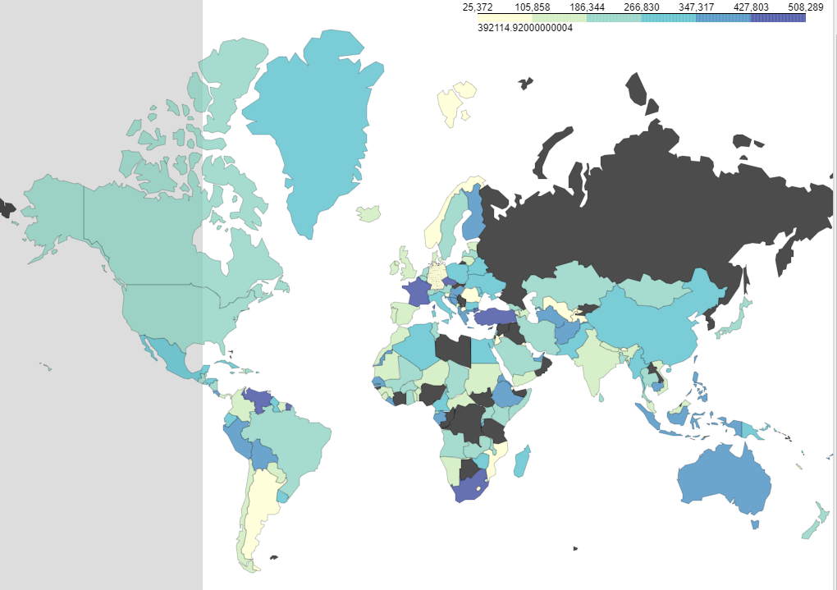
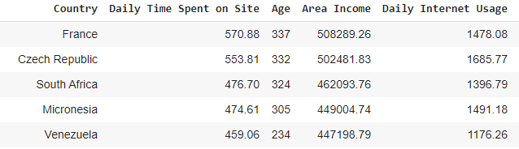
Area Income across countries

Slide 13
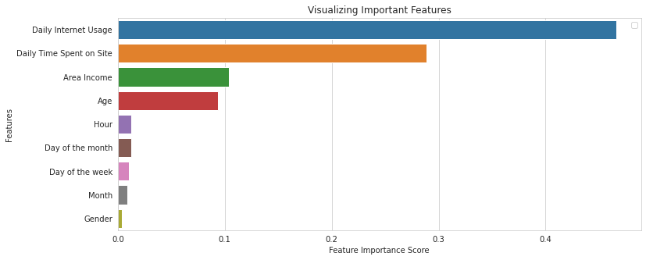
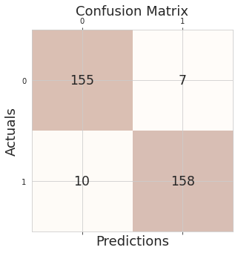
Prediction - Fitting the AI Model
Random Forest Classifier - Accuracy - 94.84%
Features to be considered - Daily Internet Usage, Daily Time Spent on SIte, Area Income and Age
Confusion Matrix - True Positive - 158, True Negative - 155 are correctly predicted

Slide 14

Conclusion
The Ad has reached the intended audience
The site has been used across various countries
Factors to be taken care for future growth:
Daily Time Spent on Site
Internet Usage
Age
Area Income

Slide 15
THANK YOU!

